Slide 1
Prediction of Nephrotic Syndrome Using Machine Learning
Pooja Prasad

Slide 2

Human-to-Agent
I
could use some help
We should prescribe rest & fun
Shouldn’t drug D1 be prescribed
Agent-to-Human
Notes:
To build a clinical support system that predicts the disease using clinical features, thus reducing the need of kidney biopsy procedure.

Slide 3
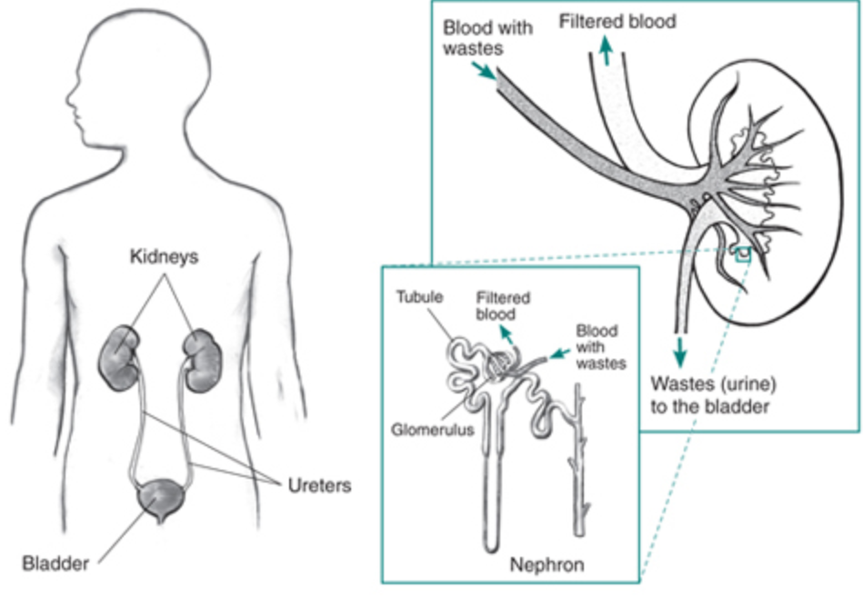
Kidneys - bean-shaped organs
Notes:
The two bean-shaped organs are the kidneys. The main function of kidney is to extract waste from the blood.
Impure blood goes into the kidney through renal artery. The kidney then extracts the waste in the form of urine and the filtered blood goes back into the body through the veins.
If we can observe the kidney minutely, we can find its building block called Nephron. And nephron has a ball like structure called glo·mer·u·lus /ɡləˈmeryələs/ which are nothing but a network of capillaries.

Slide 4
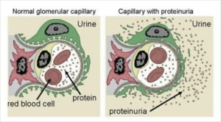
Nephrotic Syndrome
Nephrotic syndrome (NS) is not a disease, rather collection of symptoms that indicate kidney damage
Too much protein in urine - heavy proteinuria
Loss of protein from blood - hypoalbuminemia
Peripheral edema
Notes:
In normal condition, this glomerulus filters out the waste in the form of urine. But when its not healthy it also remove sgood protein from the blood.
Small amount of protein leakage is okay.But if it exceeds a threshold then it’s a problem. And this problem is called NS.
NS is indicated by too much of protein in urine – proteinuria
Loss of protein from blood – hypo- albu-mi-nemia
Nephrotic syndrome is a kidney disorder that causes your body to excrete too much protein in your urine. Nephrotic syndrome is usually caused by damage to the clusters of small blood vessels in your kidneys that filter waste and excess water from your blood
150 mg protein is normal
Signs and symptoms of nephrotic syndrome include:
Severe swelling (edema), particularly around your eyes and in your ankles and feet
Foamy urine, which may be caused by excess protein in your urine
Weight gain due to excess fluid retention
Fatigue
Loss of appetite
The glomeruli filter blood as it passes through the kidneys, separating things the body needs from those it doesn’t. Healthy glomeruli keep blood protein (mainly albumin) from seeping into the urine. Damaged glomeruli allow too much blood protein to leave the body, leading to nephrotic syndrome
It is specifically defined by the presence of heavy proteinuria (protein excretion greater than
3.5 g/24 hours), hypoalbuminemia (less than 3 g/dL), and peripheral edema

Slide 5
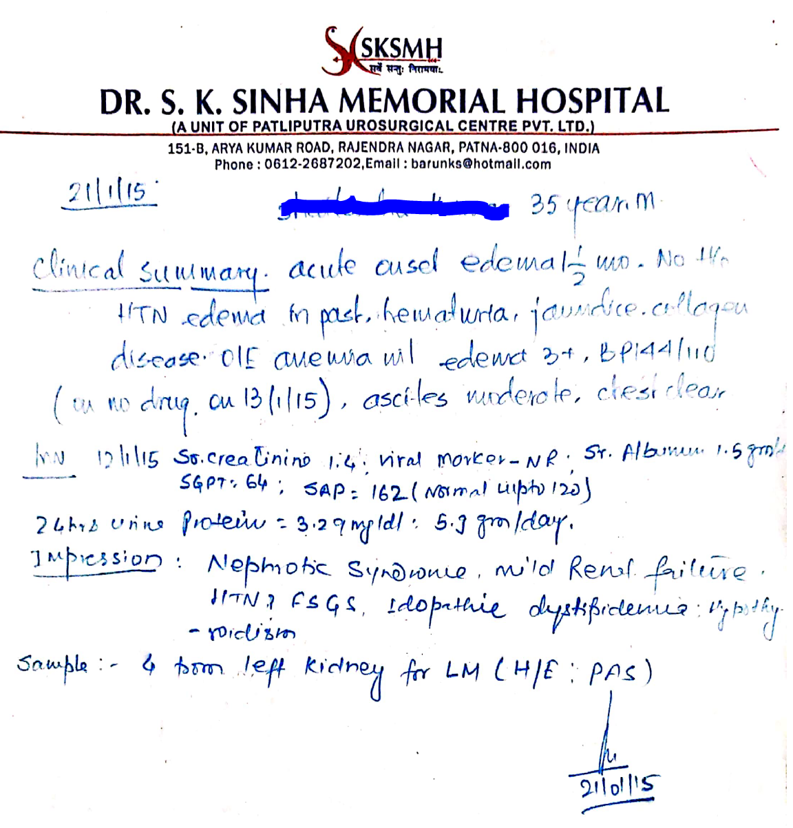
Proposed Approach
D
A
T
A
S
E T
Data Cleaning
Discriminative Machine Learning Algorithm
SMOTE
Data Transformation
Data Normalization
Clinical Data
Data Collection
Data Preprocessing
Notes:
So my approach includes Data Collection, followed by Data Preprocessing. And I have the details of only 50 patients so far so I have used SMOTE to oversample my data set.
And then Discriminative ML algorithms are applied

Slide 6
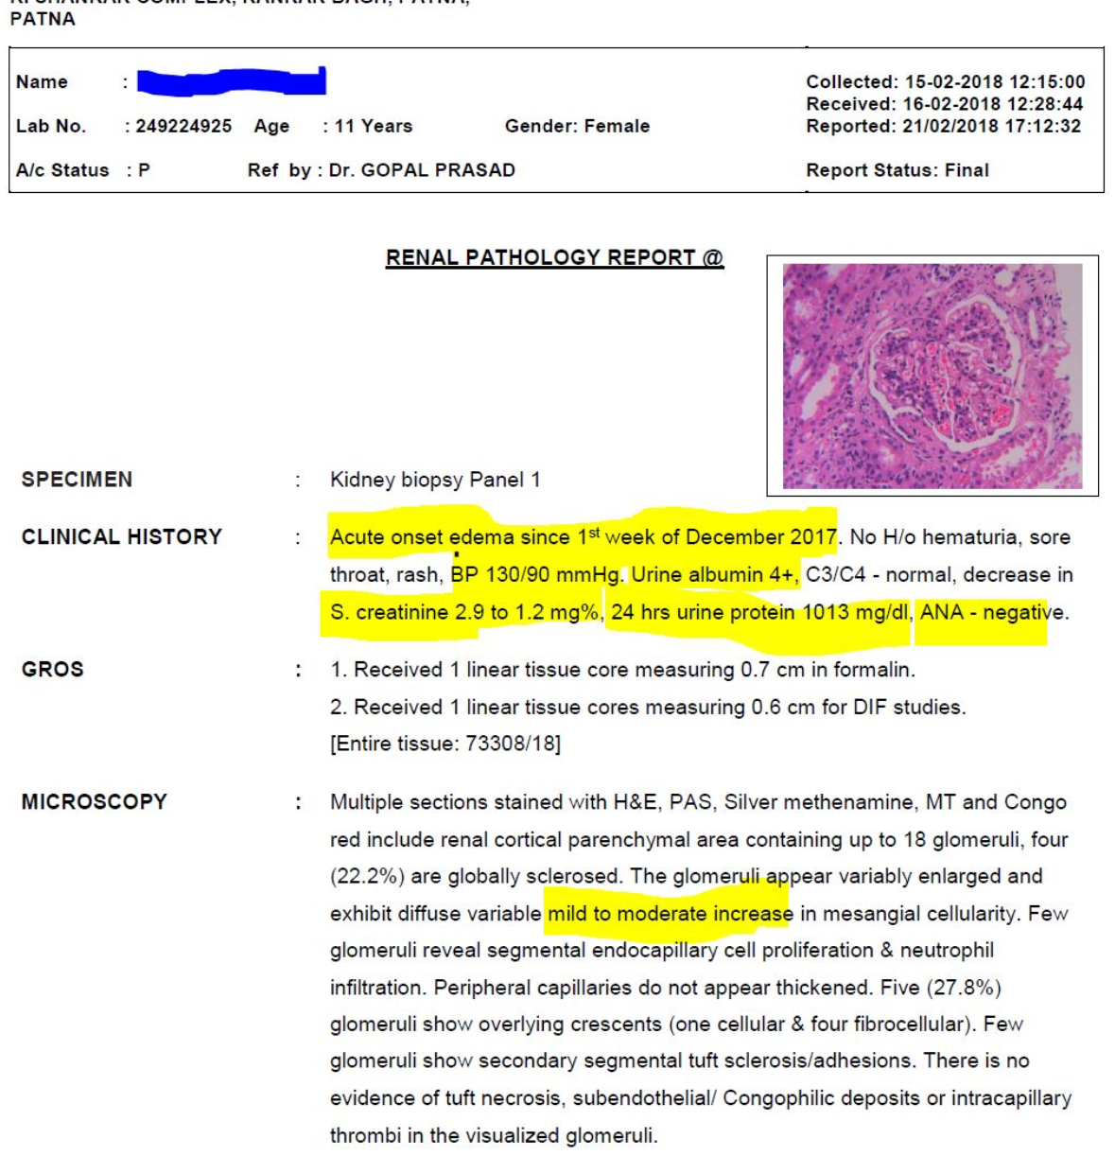

Data Collection
Notes:
I have received scanned copies of prescriptions and the renal pathological reports as data.
I started reading numbers on the prescriptions. And the impression that says NS mild renal failure is the result I needed to predict,
As we can clearly see that this is not a structured data.

Slide 7

Data Preprocessing
Noisy and Interconnected
PatientID Gender Birthdate
P1 M 3/22/63
PatientID Date Physician Symptoms Diagnosis
P1 1/1/01 Smith palpitations hypoglycemic
P1 2/1/03 Jones fever, aches influenza
Features
Patient Table
Visit Table
Objects
PatientID Date Lab Test Result
PatientID SNP1 SNP2 … SNP500K
P1 AA AB BB
P2 AB BB AA
Lab Tests
P1 1/1/01 24 hours urine 42
P1 1/9/01 blood glucose ??
SNP Table
PatientID Date Prescribed Date Filled Physician Medication Dose Duration
P1 5/17/98 5/18/98 Jones prilosec 10mg 3 months
Prescriptions
Notes:
And I needed data preprocessing to get the features and labels in the tabular format.
There was a huge possibility of noise in my data so I took the help of area expert and the computerized lab reports

Slide 8
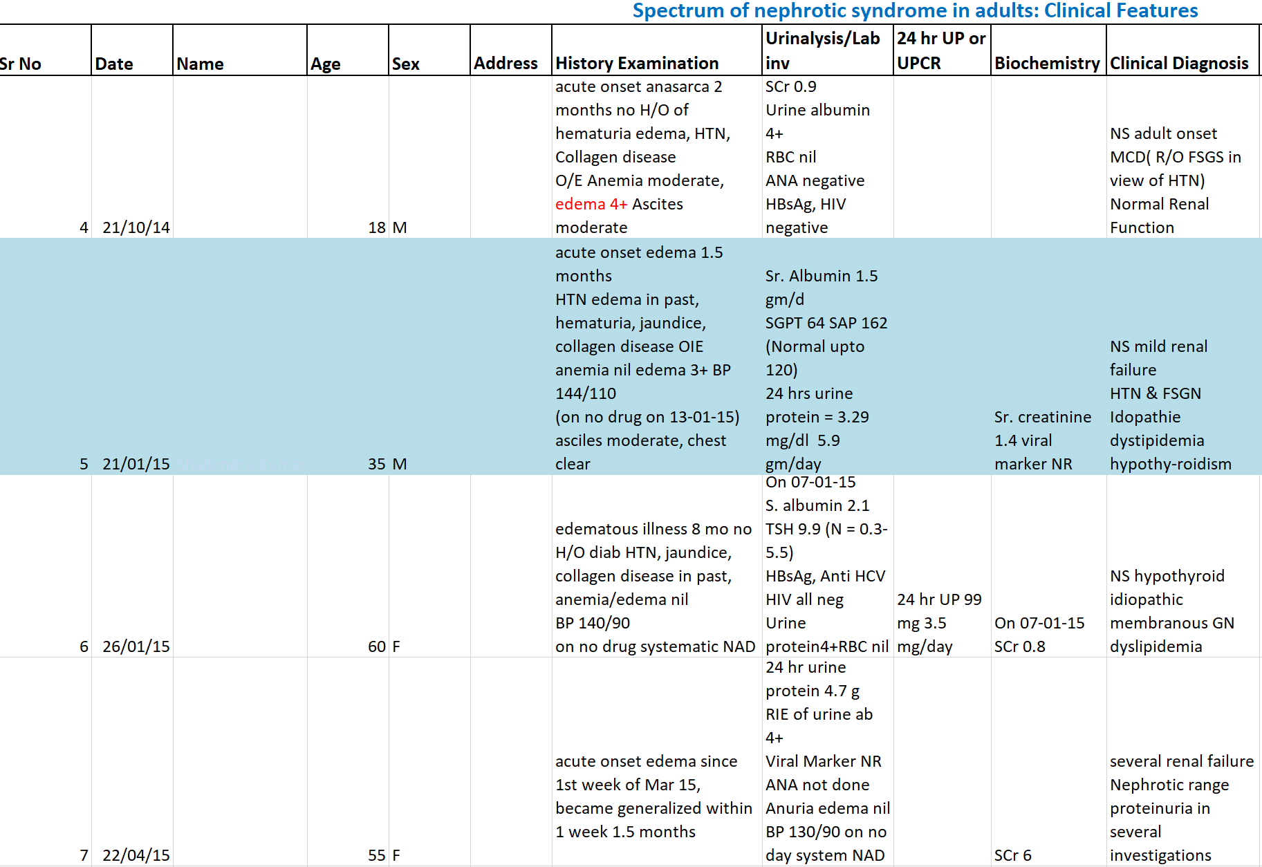
Data Cleaning
Notes:
And got my first version of data in the excel
Not structured yet, thus cannot directly be used in machine learning algorithm

Slide 9
Data Set – Features and Label
Age | Gender | ProteinuriaOnDipstick | SerumAlbumin | SerumCholestrol | SerumCr | 24HrsUrineProtein | UrineRBC | UrinePusCells | UrineCast | HBSAg | HIV | HCV | ANA | Diabetic | Edema | EdemInMonths | BPSystolic | BPDiastolic | NephroticSyndromeClassification
30 | M | 4+ | 3.1 | 222 | 1.9 | 2.5 | 12 | 29 | 0 | 0 | 0 | 0 | 0 | 0 | 1 | 36 | 122 | 80 | Mild
26 | M | 4+ | 3 | 389 | 2.5 | 5 | 25 | 0 | 1 | 1 | 0 | 0 | 0 | 0 | 1 | 1 | 140 | 100 | Moderate
18 | M | 4+ | 3 | 360 | 0.9 | 4 | 0 | 0 | 0 | 0 | 0 | 0 | 0 | 0 | 1 | 4 | 140 | 100 | Moderate
35 | M | 3+ | 1.5 | 347 | 1.4 | 5.9 | 0 | 0 | 0 | 0 | 0 | 0 | 0 | 0 | 1 | 1.5 | 144 | 110 | Moderate
60 | F | 4+ | 2.5 | 359 | 0.8 | 3.5 | 0 | 0 | 0 | 0 | 0 | 0 | 0 | 0 | 1 | 8 | 140 | 90 | Moderate
55 | F | 4+ | 2.9 | 369 | 6 | 4.7 | 0 | 0 | 0 | 0 | 0 | 0 | 0 | 0 | 0 | 0 | 130 | 90 | Moderate
45 | F | 4+ | 2.6 | 280 | 0.7 | 3.7 | 0 | 3.5 | 0 | 0 | 0 | 0 | 0 | 0 | 1 | 1 | 140 | 100 | Moderate
35 | M | 2+ | 3.5 | 220 | 0.7 | 0.68 | 0 | 0 | 0 | 0 | 0 | 0 | 0 | 0 | 0 | 0 | 120 | 80 | Normal
20 | M | 4+ | 3.5 | 210 | 1.9 | 0.28 | 0 | 0 | 0 | 0 | 0 | 0 | 0 | 0 | 0 | 0 | 120 | 80 | Normal
25 | F | 4+ | 2.9 | 312 | 1.9 | 6 | 0 | 0 | 0 | 0 | 0 | 1 | 1 | 0 | 1 | 4 | 130 | 90 | Moderate
Notes:
So I went ahead to find some of the important features that might be useful in predicting the disorder
This is my final version of structured data set with 4 different ordered labels

Slide 10
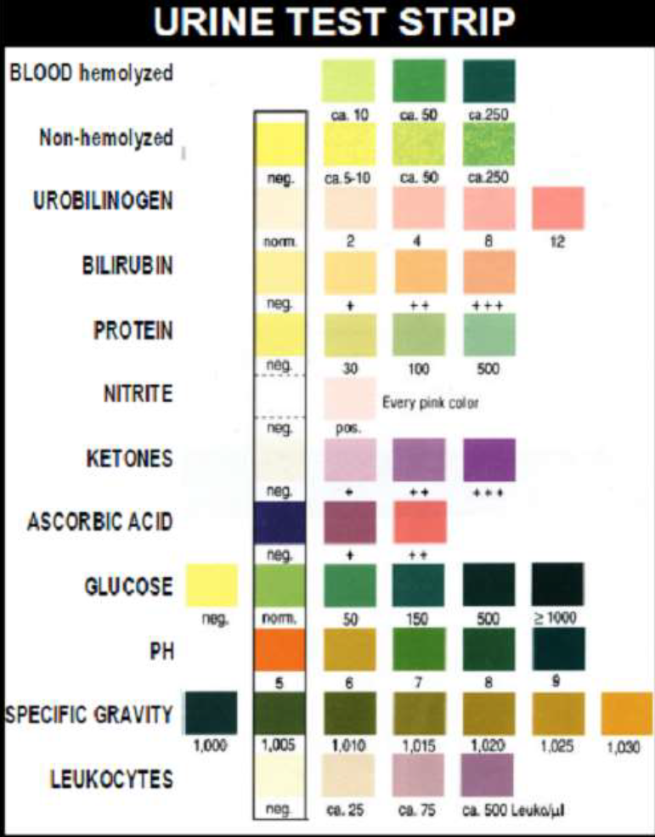
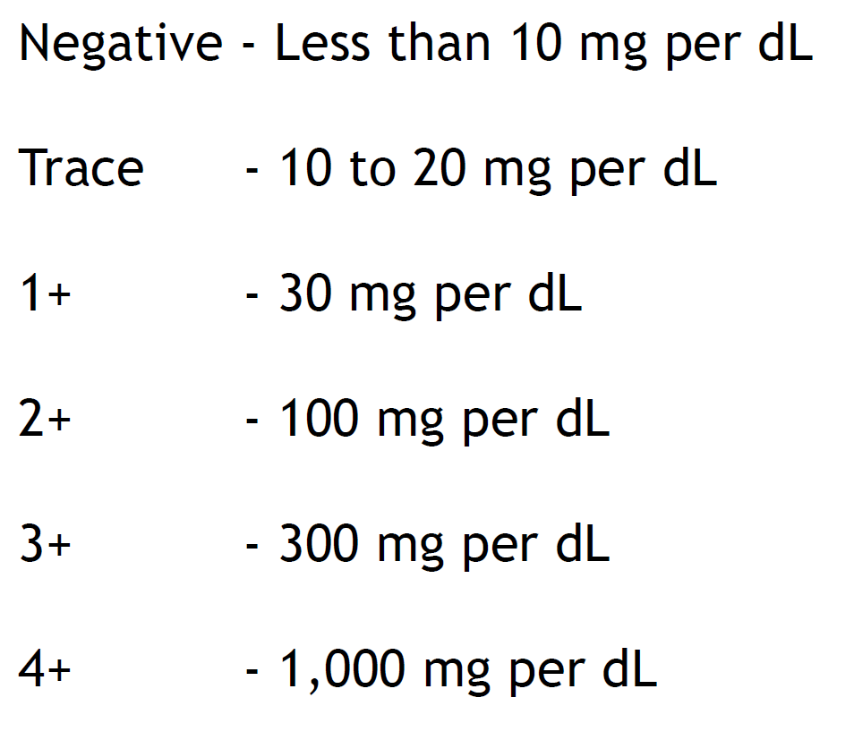
ProteinuriaOnDipstick
Age | Gender | ProteinuriaOnDipstick | SerumAlbumin | SerumCholestrol | SerumCr | 24HrsUrineProtein | UrineRBC | UrinePusCells | UrineCast | HBSAg | HIV | HCV | ANA | Diabetic | Edema | EdemInMonths | BPSystolic | BPDiastolic | NephroticSyndromeClassification
30 | M | 4+ | 3.1 | 222 | 1.9 | 2.5 | 12 | 29 | 0 | 0 | 0 | 0 | 0 | 0 | 1 | 36 | 122 | 80 | Mild
26 | M | 4+ | 3 | 389 | 2.5 | 5 | 25 | 0 | 1 | 1 | 0 | 0 | 0 | 0 | 1 | 1 | 140 | 100 | Moderate
18 | M | 4+ | 3 | 360 | 0.9 | 4 | 0 | 0 | 0 | 0 | 0 | 0 | 0 | 0 | 1 | 4 | 140 | 100 | Moderate
35 | M | 3+ | 1.5 | 347 | 1.4 | 5.9 | 0 | 0 | 0 | 0 | 0 | 0 | 0 | 0 | 1 | 1.5 | 144 | 110 | Moderate
60 | F | 4+ | 2.5 | 359 | 0.8 | 3.5 | 0 | 0 | 0 | 0 | 0 | 0 | 0 | 0 | 1 | 8 | 140 | 90 | Moderate
55 | F | 4+ | 2.9 | 369 | 6 | 4.7 | 0 | 0 | 0 | 0 | 0 | 0 | 0 | 0 | 0 | 0 | 130 | 90 | Moderate
45 | F | 4+ | 2.6 | 280 | 0.7 | 3.7 | 0 | 3.5 | 0 | 0 | 0 | 0 | 0 | 0 | 1 | 1 | 140 | 100 | Moderate
35 | M | 2+ | 3.5 | 220 | 0.7 | 0.68 | 0 | 0 | 0 | 0 | 0 | 0 | 0 | 0 | 0 | 0 | 120 | 80 | Normal
20 | M | 4+ | 3.5 | 210 | 1.9 | 0.28 | 0 | 0 | 0 | 0 | 0 | 0 | 0 | 0 | 0 | 0 | 120 | 80 | Normal
25 | F | 4+ | 2.9 | 312 | 1.9 | 6 | 0 | 0 | 0 | 0 | 0 | 1 | 1 | 0 | 1 | 4 | 130 | 90 | Moderate
Notes:
So the very first test that patient undergoes is Proteinuria on dipstick.
It’s a urine test strip with different ordered markers
For example 4+ indicates the presence of >1 gm of protein per dL of urine and so on

Slide 11
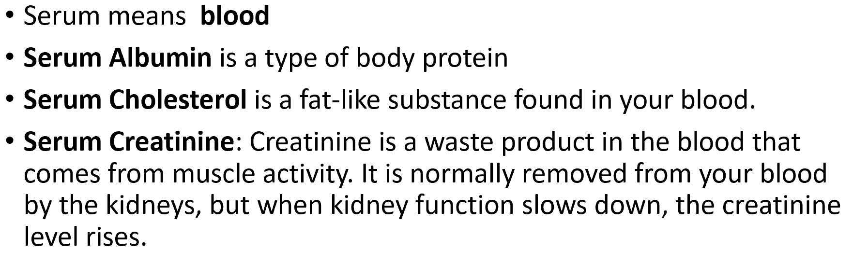
Features from Blood Report
 | SerumAlbumin | SerumCholestrol | SerumCr | 24HrsUrineProtein | UrineRBC | UrinePusCells | UrineCast | HBSAg | HIV | HCV | ANA | Diabetic | Edema | EdemInMonths | BPSystolic | BPDiastolic | NephroticSyndromeClassification
 | 3.1 | 222 | 1.9 | 2.5 | 12 | 29 | 0 | 0 | 0 | 0 | 0 | 0 | 1 | 36 | 122 | 80 | Mild
 | 3 | 389 | 2.5 | 5 | 25 | 0 | 1 | 1 | 0 | 0 | 0 | 0 | 1 | 1 | 140 | 100 | Moderate
 | 3 | 360 | 0.9 | 4 | 0 | 0 | 0 | 0 | 0 | 0 | 0 | 0 | 1 | 4 | 140 | 100 | Moderate
 | 1.5 | 347 | 1.4 | 5.9 | 0 | 0 | 0 | 0 | 0 | 0 | 0 | 0 | 1 | 1.5 | 144 | 110 | Moderate
 | 2.5 | 359 | 0.8 | 3.5 | 0 | 0 | 0 | 0 | 0 | 0 | 0 | 0 | 1 | 8 | 140 | 90 | Moderate
 | 2.9 | 369 | 6 | 4.7 | 0 | 0 | 0 | 0 | 0 | 0 | 0 | 0 | 0 | 0 | 130 | 90 | Moderate
 | 2.6 | 280 | 0.7 | 3.7 | 0 | 3.5 | 0 | 0 | 0 | 0 | 0 | 0 | 1 | 1 | 140 | 100 | Moderate
 | 3.5 | 220 | 0.7 | 0.68 | 0 | 0 | 0 | 0 | 0 | 0 | 0 | 0 | 0 | 0 | 120 | 80 | Normal
 | 3.5 | 210 | 1.9 | 0.28 | 0 | 0 | 0 | 0 | 0 | 0 | 0 | 0 | 0 | 0 | 120 | 80 | Normal
 | 2.9 | 312 | 1.9 | 6 | 0 | 0 | 0 | 0 | 0 | 1 | 1 | 0 | 1 | 4 | 130 | 90 | Moderate
Notes:
We also have some features from blood report.

Slide 12
Features – Urine Test , Blood Pressure & Other Clinical Tests
 | 24HrsUrineProtein | UrineRBC | UrinePusCells | UrineCast
 | 2.5 | 12 | 29 | 0
 | 5 | 25 | 0 | 1
 | 4 | 0 | 0 | 0
 | 5.9 | 0 | 0 | 0
 | 3.5 | 0 | 0 | 0
 | 4.7 | 0 | 0 | 0
 | 3.7 | 0 | 3.5 | 0
 | 0.68 | 0 | 0 | 0
 | 0.28 | 0 | 0 | 0
 | 6 | 0 | 0 | 0
BPSystolic | BPDiastolic
122 | 80
140 | 100
140 | 100
144 | 110
140 | 90
130 | 90
140 | 100
120 | 80
120 | 80
130 | 90
HBsAg | HIV | HCV | ANA | Diabetic
0 | 0 | 0 | 0 | 0
1 | 0 | 0 | 0 | 0
0 | 0 | 0 | 0 | 0
0 | 0 | 0 | 0 | 0
0 | 0 | 0 | 0 | 0
0 | 0 | 0 | 0 | 0
0 | 0 | 0 | 0 | 0
0 | 0 | 0 | 0 | 0
0 | 0 | 0 | 0 | 0
0 | 0 | 1 | 1 | 0
Hepatitis B surface antigen Test
Human immunodeficiency virus
Test
Hepatitis C virus Test
Antinuclear antibody Test
Notes:
We also have features from urine test, BP and other clinical test.
So we need to make sure that the patient is not suffering from any other diseases like Hepatitis B, Hepatitis C, HIV etc.
These features are coded in 1 hot vector where 1 means that the patient has positive result for the particular disease.

Slide 13
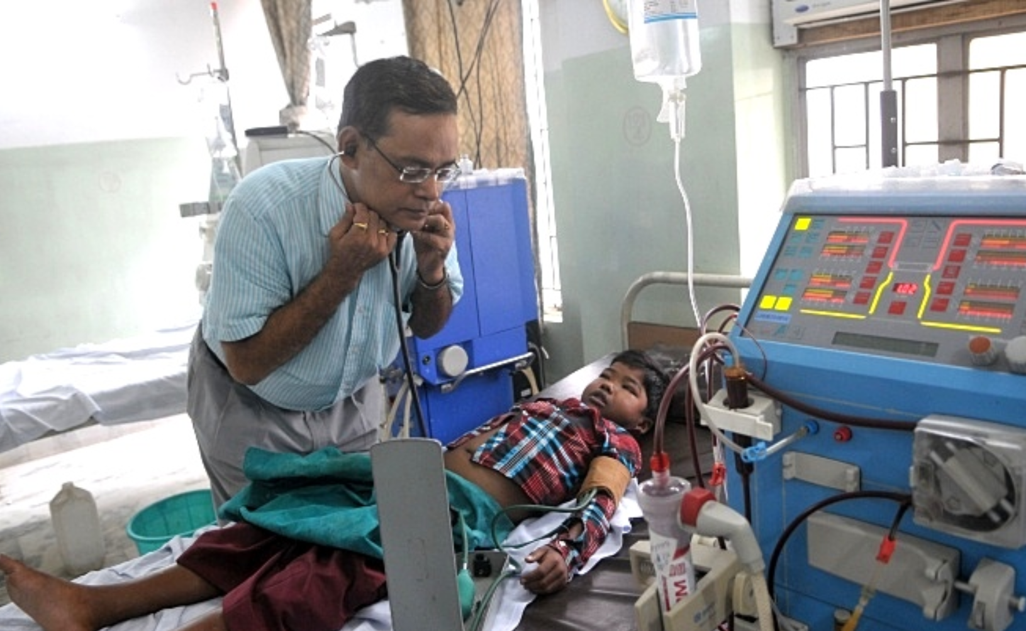
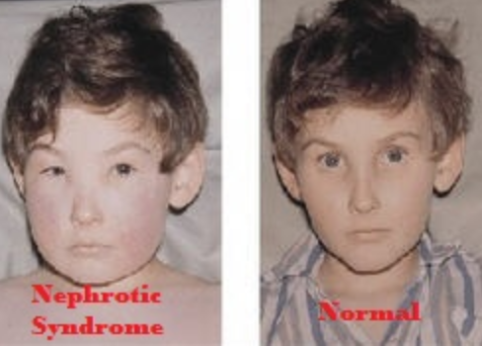
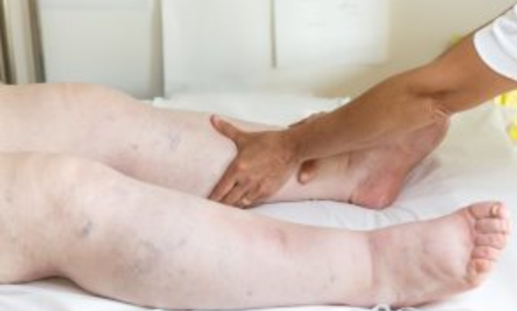
Feature - Edema
Edema | EdemInMonths
1 | 36
1 | 1
1 | 4
1 | 1.5
1 | 8
0 | 0
1 | 1
0 | 0
0 | 0
1 | 4
Notes:
The last feature is edema.

Slide 14
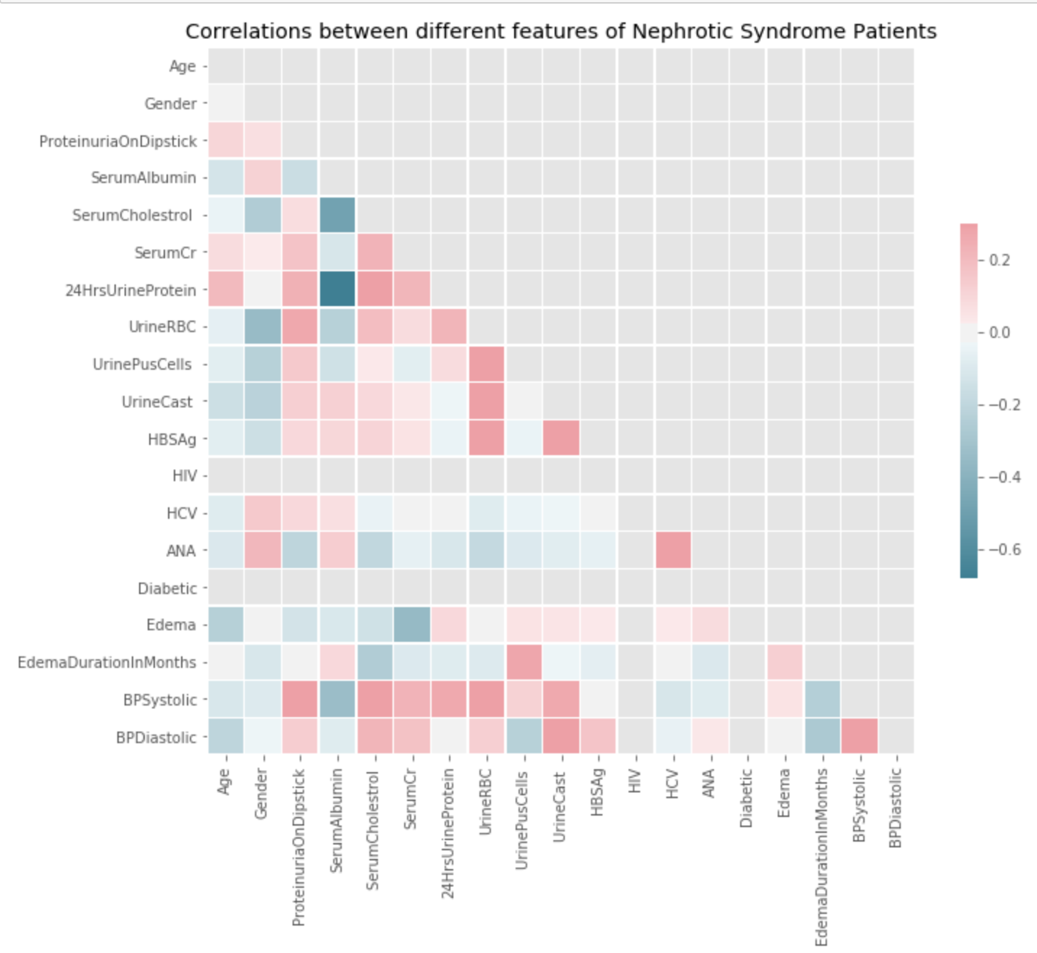
Exploratory Data Analysis
Serum Albumin
Negative
Correlation
24 hrs Urine Protein
Serum Albumin
Negative
Correlation
Serum Cholesterol
Serum Cholesterol
Positive
Correlation
24 hrs Urine Protein

Slide 15
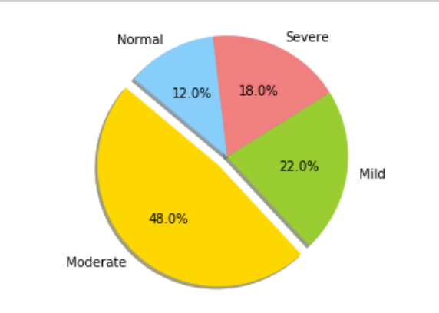
Multiclass Classification
SMOTE: Synthetic Minority Over-sampling TEchnique
Minority class is over-sampled by creating “synthetic” examples
Take each minority class sample -> find k minority class nearest neighbors -> choose neighbors randomly based on amount of oversampling
Synthetic samples generation: Take the difference between the feature vector (sample)
under consideration and its nearest neighbor. Multiply this difference by a random number
between 0 and 1, and add it to the feature vector under consideration.
Performed on train data set
SMOTE: https://www.jair.org/index.php/jair/article/view/10302/24590
Notes:
Now coming to my problem
My problem is multi class classification with around 50% of the labels characterized in Moderate stage.
And that’s why I performed Synthetic Minority Over Sampling Technique to get synthetic examples on my training set. I was careful not to
use my test set to avoid leaking information from test set during training the model.

Slide 16
Machine Learning Algorithms Used
Decision Tree
DecisionTreeClassifier(max_depth = 2).fit(X_train_res, y_train_res)
Support Vector Machine
SVC(kernel = 'linear', C = 1).fit(X_train_res, y_train_res)
K Nearest Neighbours
KNeighborsClassifier(n_neighbors = 5).fit(X_train_res, y_train_res)
Notes:
The parameters like max depth , kernels etc are hypertuned using grid search and cross validation

Slide 17
Metrics
Accuracy is not a good evaluation metric - with imbalanced classes, it’s easy to get a high accuracy without actually making useful predictions
Precision-Recall and f score are useful measures of success of prediction
Small dataset -> Overfitting
Cross validation to prevent overfitting
Notes:
Accuracy is not a good measure due to the imbalance nature of the data set and so I have used precision recall and F1 score to measure the success of prediction

Slide 18
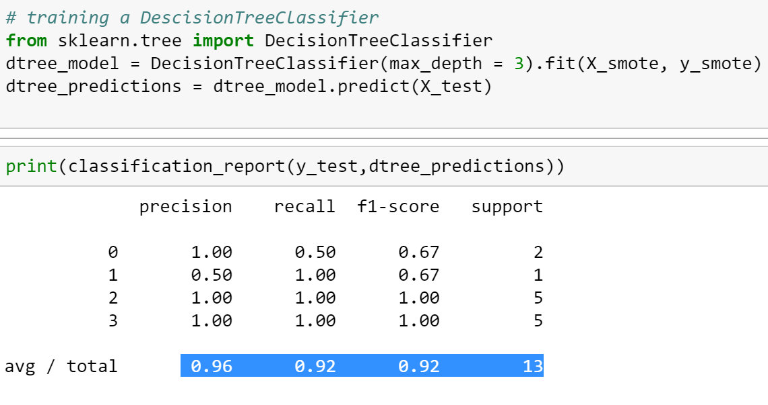
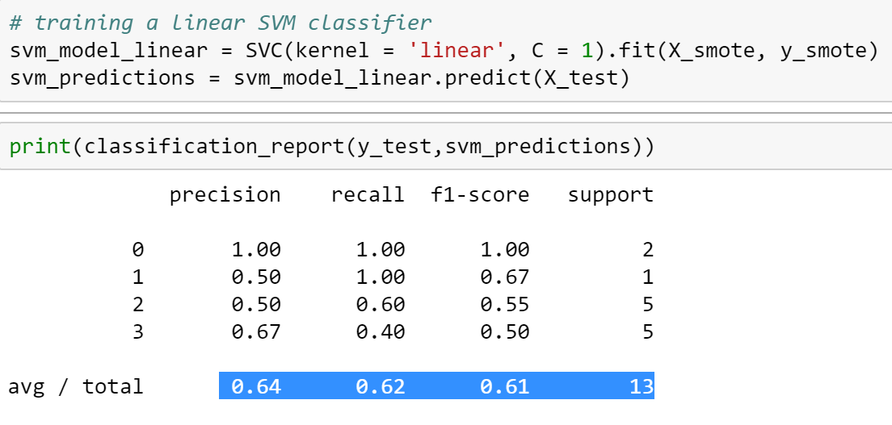
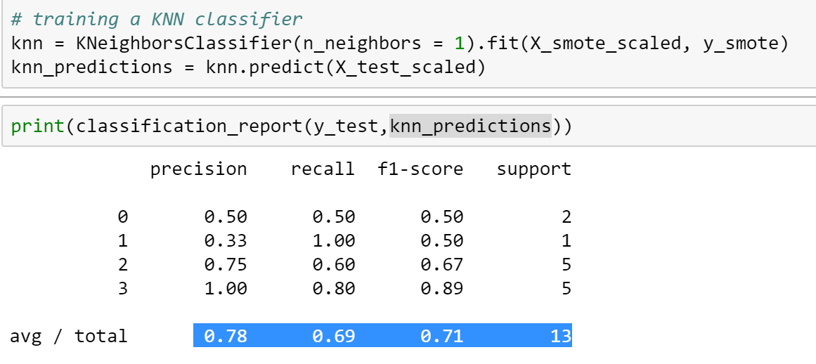
Evaluation
NO Free Lunch Theorem!
Notes:
This is the result found for each algorithm

Slide 19
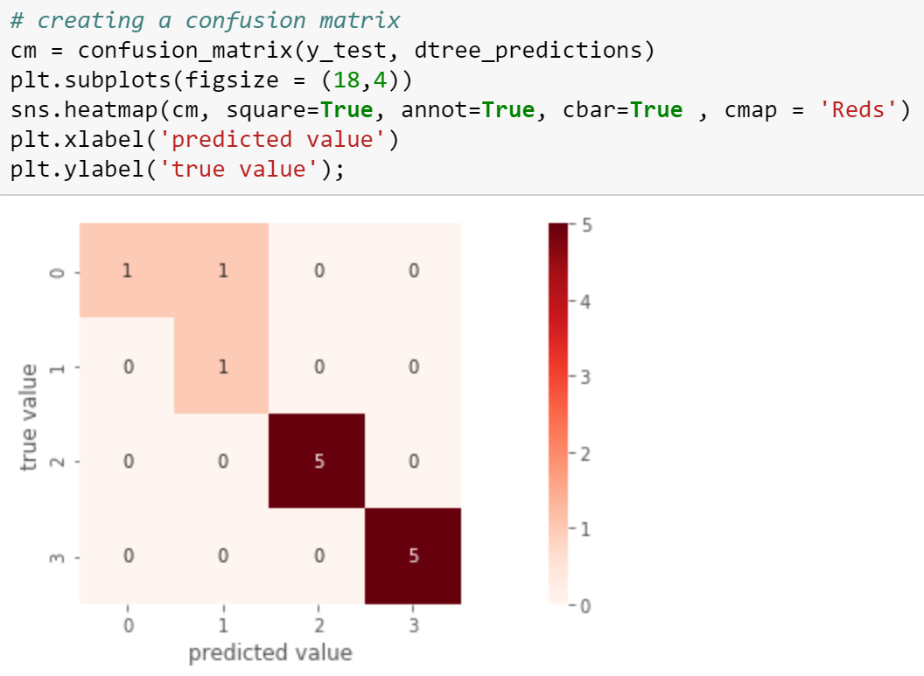
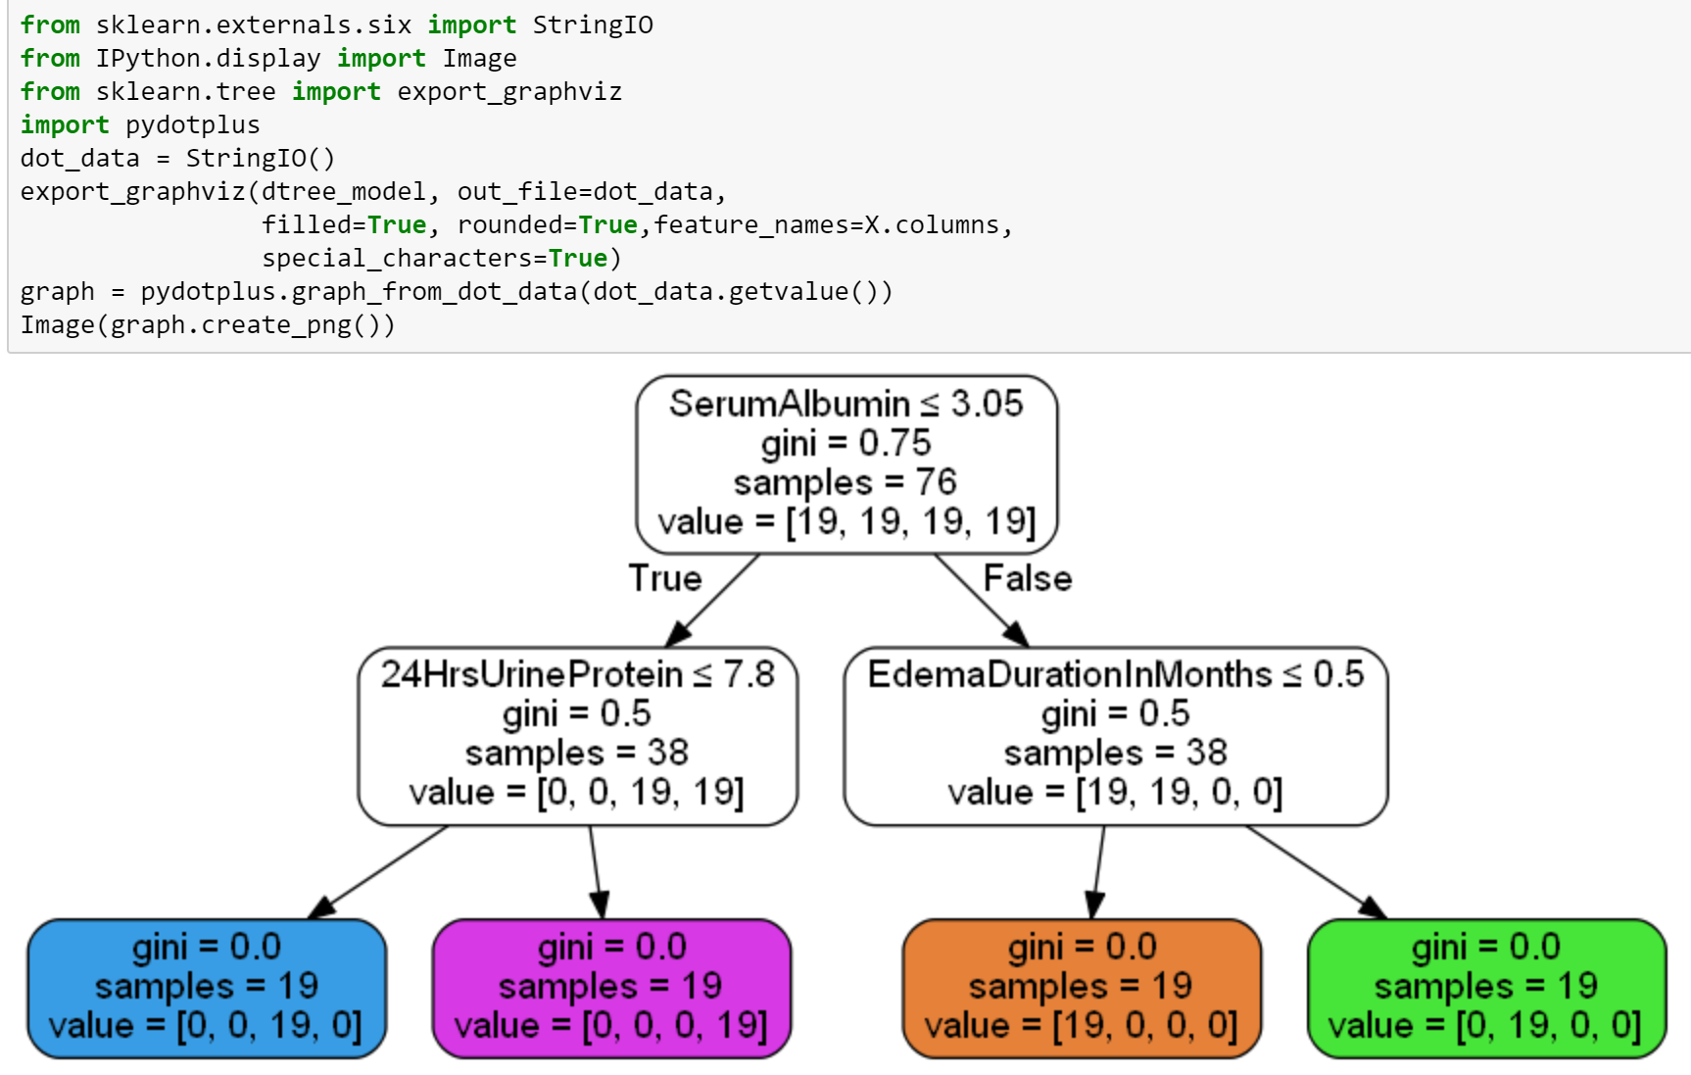
Evaluation

Slide 20
Conclusion & Future directions
Decision Tree is the best machine learning algorithm with high precision and high recall
Serum Albumin, 24 hrs urine protein, duration of edema are among the best features to consider for predicting Nephrotic Syndrome
Next Steps
Collecting more patients data and re-train the algorithms
Transfer Learning
Few-shot Learning
Use a combination of clinical report and biopsy images to further classify the problem using U-net

